Slide 1

Non-persistence,1-persistence,p-persistence strategies
Describe CSMA
PRESENTED BY-
ADARSHA MONDAL
DEPT.:-CSE
ROLL NO:-16800117062

Slide 2
CONTENT
INTRODUCTION
WHAT IS CSMA
ASSUMPTIONS OF CSMA NETWORKS
TYPES OF CSMA PROTOCOL
1-PERSITENCE CSMA
NON-PERSISTENCE CSMA
P-PERSISTENCE CSMA

Slide 3
CONTENT
Tradeoff between 1- and Non Persistent CSMA
DIFFERENCE BETWEEN PERSISTENCE AND NON-PERSISTENCE STRATEGIES
CSMA EFFICIENCY
CSMA / CD : Network components
CSMA / CD : Topologies, media , etc.
CSMA/CD
CSMA PROTOCOL DIAGRAM AND DESCRIPTION
CONCLUTION

Slide 4
INTRODUCTION
The Internet has made large amount of information available to the average computer user at home, in Business and Education.
For many people,having access to this information is no longer just an advantage, it is essential.
Carrier-sense multiple access (CSMA) is a media access control (MAC) protocol in which a node verifies the absence of other traffic before transmitting on a shared transmission medium, such as an electrical bus or a band of the electromagnetic spectrum.

Slide 5
CSMA(Carrier Sense Multiple Access)
CSMA: Its concept is simply listen before talk (LBT)
•If channel is sensed idle : transmit entire frame
• If channel is sensed busy : defer transmission
• We could achieve better throughput if we could listen to the channel before transmitting a packet
• This way, we would stop avoidable collisions
• To do this, we need CSMA protocols

Slide 6
Assumptions with CSMA Networks
• Constant length packets
• No errors, except those caused by collisions
• No capture effect
• Each host can sense the transmissions of all other hosts • The propagation delay is small compared to the transmission time

Slide 7
TYPES OF CSMA PROTOCOL
• There are several types of CSMA protocols
– 1-Persistent CSMA
– Non-Persistent CSMA
– P-Persistent CSMA

Slide 8
1-Persistent CSMA
• Sense the channel
– If busy, keep listening to the channel and transmit immediately when the channel becomes idle
– If idle, transmit a packet immediately
If collision occurs
– Wait a random amount of time and start over again
This protocol is called 1-persistent because the host transmits with a probability of 1 whenever it finds the channel idle

Slide 9
1-Persistent CSMA
• No longer propagation delay
• Even if prop. delay is zero, there will be collisions
EXAMPLE
- If stations B and C become ready in the middle of A’s transmission, B and C will wait until the end of A’s transmission and then both will begin transmitted simultaneously, resulting in a collision
- If B and C were not so greedy, there would be fewer collisions

Slide 10
Non-Persistent CSMA
• Sense the channel
– If busy, wait a random amount of time and sense the channel again
– If idle, transmit a packet immediately
• If collision occurs
– wait a random amount of time and start all over again
Merits
• Better channel utilization
• Longer delays
• Reduces chances of collision
• Reduces efficiency

Slide 11
P-Persistent CSMA
• Applicable to slotted channels
• When a station becomes ready to send, it senses the channel
– if it is idle, station transmits with a probability of p
– it defers until next slot with a probability of q = 1-p
• If the slot is also idle
– either station transmits or it defers with probabilities of p & q
• This is repeated until either the frame has been transmitted or another station begun transmitting

Slide 12
Tradeoff between 1- and Non Persistent CSMA
• If only B becomes ready in the middle of A’s transmission
– 1-Persistent: B succeeds as soon as A ends
– Non-Persistent B may have to wait
• If B and C become ready in the middle of A’s transmission
– 1-Persistent B and C collide
– Non-Persistent B and C probably do not collide

Slide 13
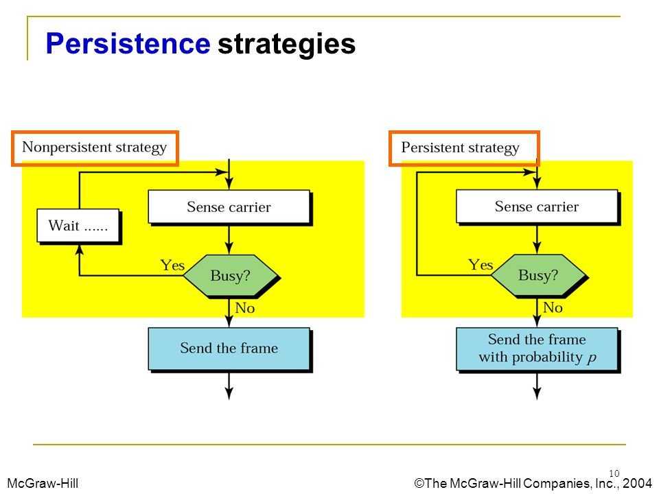
DIFFERENCE BETWEEN PERSISTENCE AND NON-PERSISTENCE STRATEGIES

Slide 14
CSMA efficiency
• Decreases with t (prop) / t (trans)
• Decreases with increasing distance between nodes
• So, efficiency decreases with increasing link speed R

Slide 15
CSMA / CD : Network components
CSMA / CD : Network components
• Medium (coax, tp, fiber)
• Transceivers
• AUI cable (drop cable; station to coax)
• NIC (network interface card -MAC protocol logic)
• Repeaters (needed to extend coax)
• Test equipment
• Hub (multipart repeater) : for star configuration
• Bridges (to connect to other LANs)

Slide 16
CSMA / CD : Topologies, media , etc.
• media
– coaxial cable
– twisted pair
– fiber (less common)
• topologies
– bus
- original design; widespread for many years
– star with hub in middle; now becoming common
• data rates
– 10 Mbps
– 100 Mbps
– Gbps on the way

Slide 17
CSMA / CD
Sending nodes are able to detect collisions while transmitting
• If medium is idle , transmits
• If busy, listens for idle then transmits
• While transmitting node continues to listen to see
if a collision has occoured
• If collision detected stops transmission, generates a
jamming signal on the bus to indicate all nodes
about

Slide 18
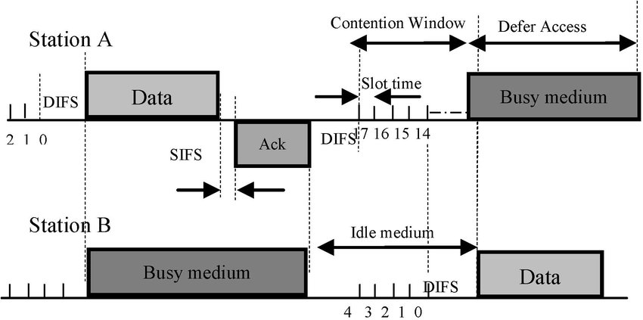
CSMA/CD Protocol
TIMING DIAGRAM OS CSMA/CD PROTOCOL

Slide 19
CSMA/CD Protocol
• All hosts transmit & receive on one channel
• Packets are of variable size
• When a host has a packet to transmit
1. Carrier Sense: Check that the line is idle before transmitting
2. Collision Detection: Detect collision as soon as possible If a collision is detected, stop transmitting; wait a random time, sense the channel again

Slide 20
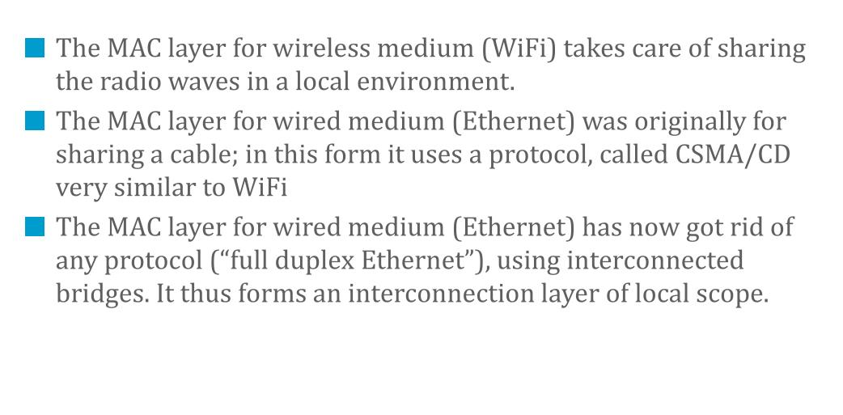
CONCLUTION

